Slide 1
OPEN ACCESS MONOGRAPHS
PROFESSOR SHEARER WEST
DEPUTY VC AND PROVOST, UNIVERSITY OF SHEFFIELD
CHAIR OF UUK OPEN ACCESS MONOGRAPH GROUP

Slide 2
Monographs
‘Writing a monograph allows the author to weave a complex and reflective narrative, tying together a body of research in a way that is not possible with journal articles or other shorter outputs.’
Geoff Crossick
In Open Access discussions, the monograph is sometimes referred to as a Long Form Publication

Slide 3



Emotional pull

Slide 4
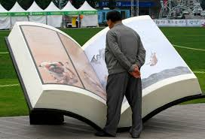

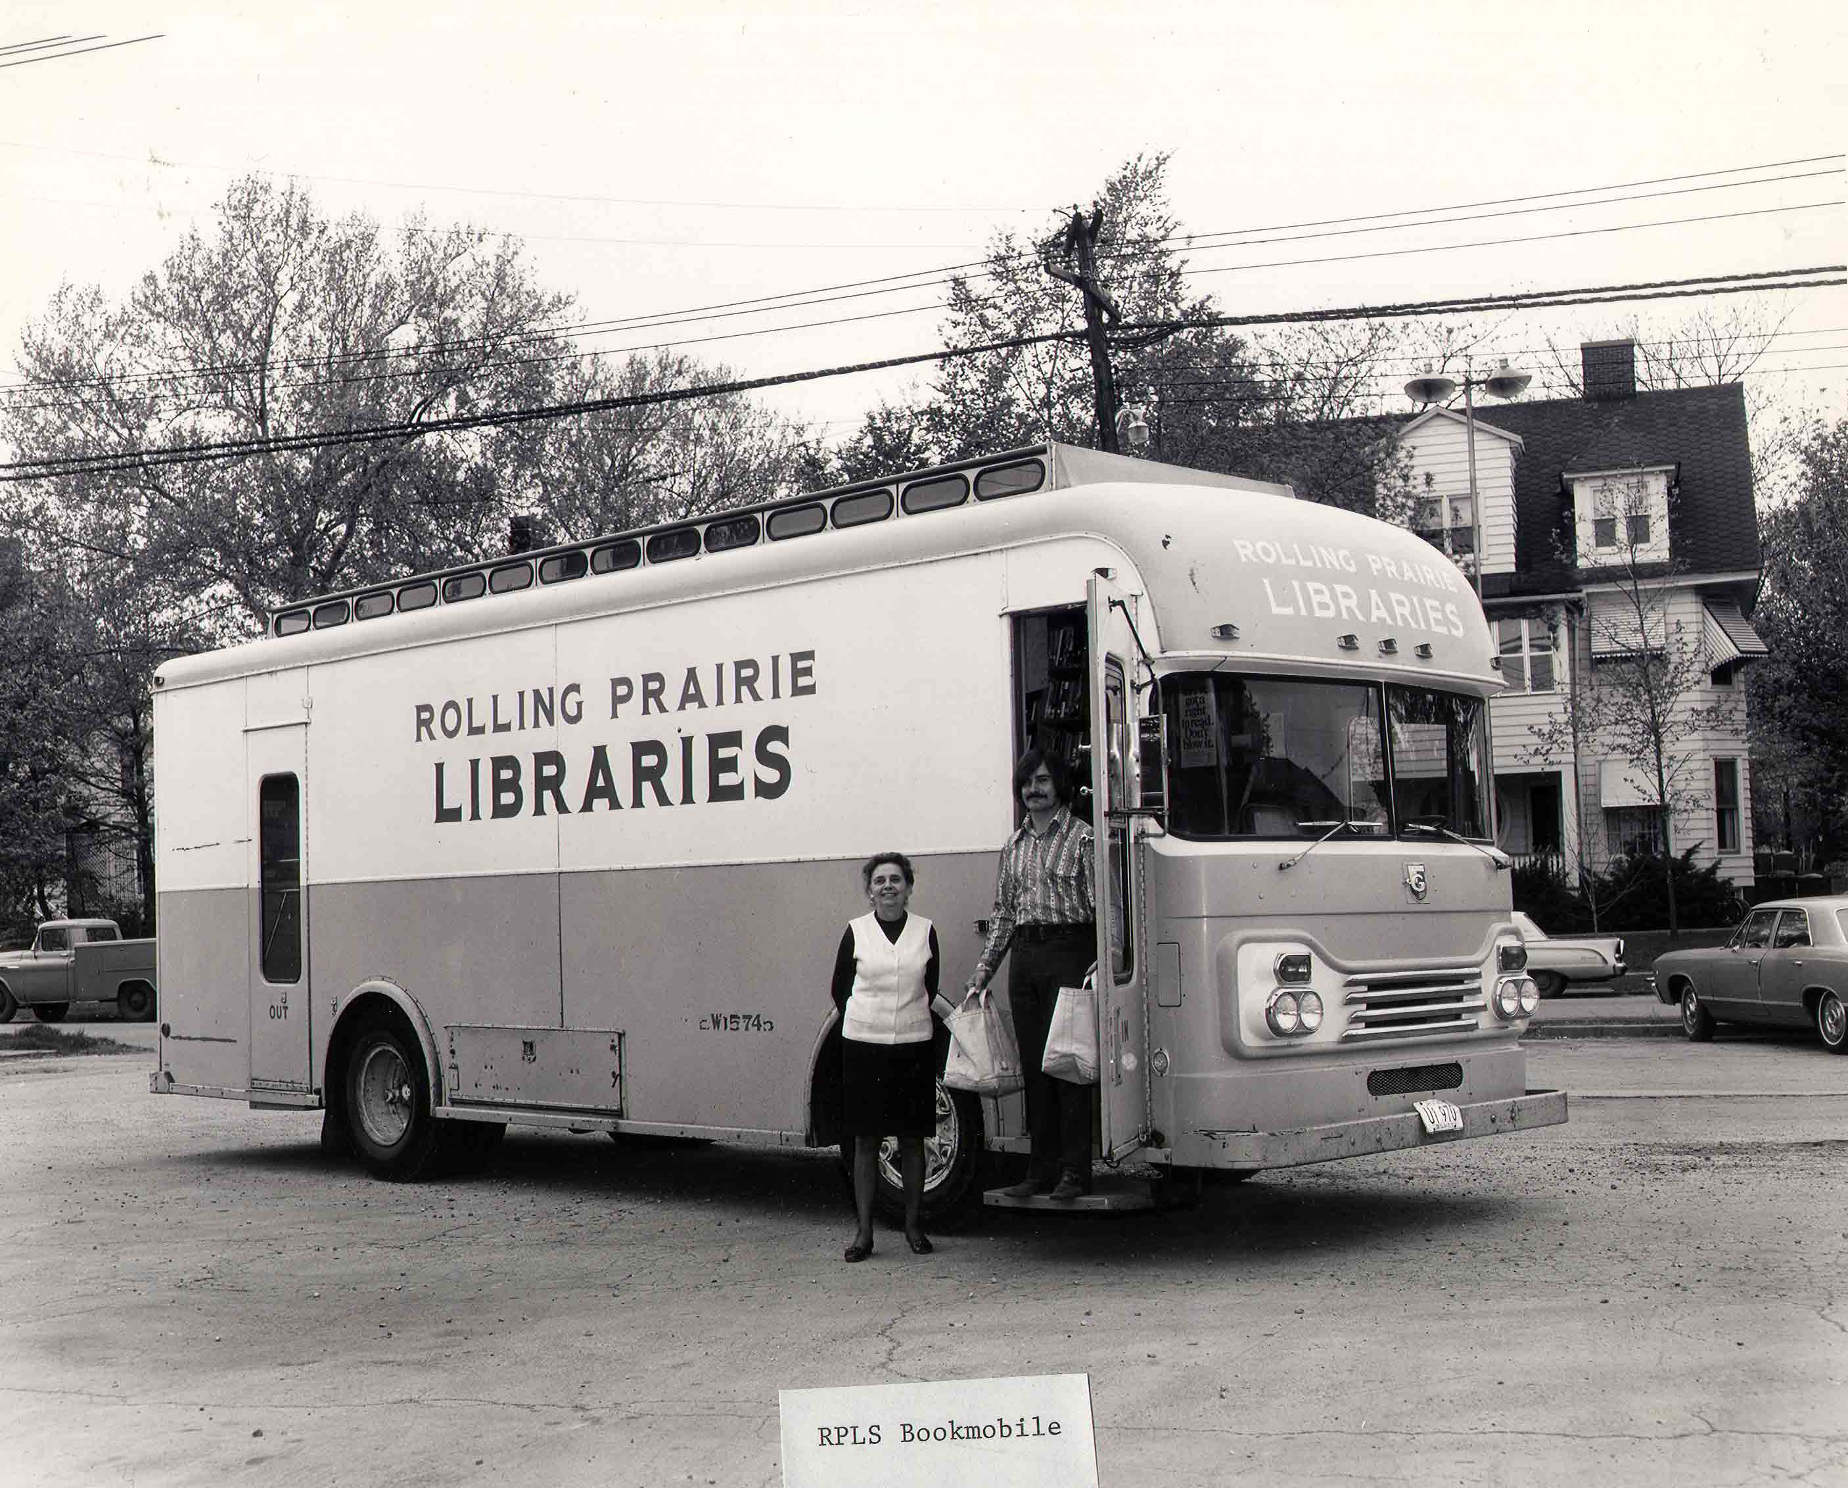
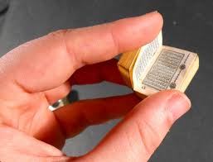
Emotional drag

Slide 5





Disruptive technologies

Slide 6
Open Access
‘Making scholarly literature available for free via the internet so that it can be read, downloaded, copied, distributed, printed, searched, text-mined or used for any other lawful purpose without financial, legal or technical barriers, as long as authors are attributed.’
OAPEN-UK

Slide 7
Why now?
REF 2021 Technical Consultation Annex C:
‘We have already stated that monographs and other long-form research outputs need not be available in an open-access form to be eligible for submission to the next REF. In the long term, however, we want to see the benefits that open access has brought to journal articles extended to other research outputs, including monographs. We therefore intend to move towards an open-access requirement for monographs in the exercise that follows the next REF…Given the length of time required to produce and publish monographs, we are signaling this now, to give due notice to the sector.’

Slide 8
Recent Policy Papers and Projects
Geoffrey Crossick, ‘Monographs and Open Access: A report to HEFCE’, January 2015 (http://www.hefce.ac.uk/pubs/rereports/year/2015/monographs/ )
Nigel Vincent, ‘The Monograph Challenge’, British Academy, 2013 (http://www.britac.ac.uk/sites/default/files/Documents/Debating%20Open%20Access-Vincent-The%20Monograph%20Challenge%20(June%202013).pdf )
Ellen Collins, et al, ‘Guide to Open Access Monograph Publishing for Arts, Humanities and Social Science Researchers’, OAPEN-UK, 2013 (https://issuu.com/carenmilloy/docs/guide_to_open_access_monograph_publ )
‘Open Access Opportunities for the Humanities’, Science Europe, November 2013 (http://www.scienceeurope.org/wp-content/uploads/2014/05/SE_Humanities_Paper_FIN.pdf )
Academic Book of the Future, AHRC project, launch June 2017 (https://academicbookfuture.org/ )

Slide 9
Evidence and observations
Information gathered in 2010 showed that in the 2000-2010 decade, library print book publishing expenditure declined from 11,9% in 1999 to 8.4% in 2009.
REF evidence shows a large percentage of monographs in outputs for disciplines like English, History and French, but much lower in Philosophy and Linguistics.
Crossick says there is ‘no crisis’ of the monograph, but opportunities are being missed.
OAPEN UK surveyed 700 HSS academics. Only 50% of them were aware of OA and only 30% familiar with it.

Slide 10
Advantages of an open access monograph
Reach (Knowledge Unlatched found that 27 titles in a 24 week period were downloaded 12,763 times from 138 countries)
Impact
Manoeuverability
Enhance means of interacting (including peer review, see arXiv)
International context shows move to OA in many countries
No price barriers for the reader
Easier use in teaching
Growth of readership in developing world countries (e.g. Open Book Publishers evidence)

Slide 11
Open access and social inclusion
‘The OA movement is motivated by the problems of social inequality caused by restricting access to academic research which favor large and wealthy institutions with the financial means to purchase access to many journals, as well as the economic challenges and perceived unsustainability of academic publishing.’
Wikipedia

Slide 12
Anxieties and obstacles
Competing demands and expectations of stakeholders (authors, publishers, readers, libraries, policymakers, learned societies and research funders)
Licensing (especially with trade books/royalties, distinctive academic voice)
Concerns about third party rights
Concerns about an author pays business model in a set of disciplines with a low level of grant funding
Digital books not felt to be user friendly
Quality control, peer review
Publisher brand
Jargon (APCs, CC-by, gold and green, repository)

Slide 13
Unpacking the jargon
Gold OA: work immediately available OA upon publication
Green OA: work available OA in a repository, normally self-archived, sometimes after an embargo period
APC (article processing charge): fee charged to authors to make the work available OA
Creative Commons Licenses (CC BY, CC BY-SA, CC BY-ND, CC BY-NC, CC BY-NC-SA etc): all are versions of restrictions on sharing, redistributing, remixing, transforming and building. In every case the author must be attributed.

Slide 14
Conservativism
Martin Paul Eve on the core barriers to OA publishing:
Publishers expect OA to be risk free
Academics want things to continue as they are
Libraries don’t want costs to go up
Hiring and assessing panels still use hard copy as a proxy for
quality
BUT:
Readers expect books free online
https://www.martineve.com/2017/01/02/four-implementation-questions-about-open-access-and-monographs/

Slide 15
Some Experiments
Open Book Publishers (books can be read online but not manipulated) http://www.openbookpublishers.com/
Knowledge Unlatched (consortium model) www.knowledgeunlatched.org
Open Library of the Humanities (low APCs) https://www.openlibhums.org
Austrian Science Foundation (FWF): grants of 14K euros for OA publishing
Wellcome mandating OA publishing
AHRC allowing OA charges as part of directly incurred costs

Slide 16


Imagining a Disruptive World

Slide 17
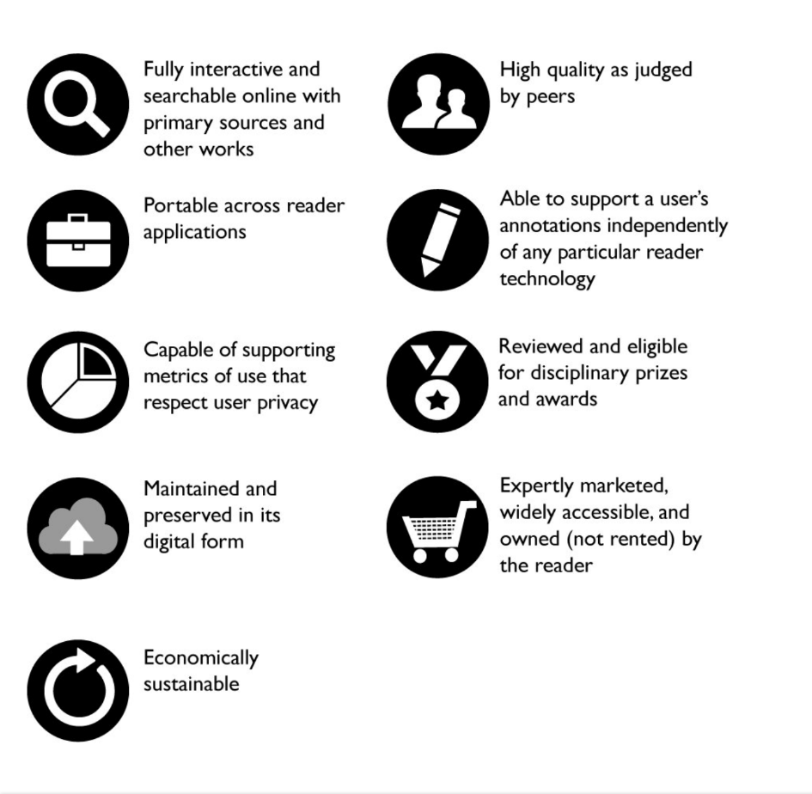
Donald Waters, ‘Monograph Publishing in the Digital Age’, Andrew Mellon Foundation (https://mellon.org/resources/shared-experiences-blog/monograph-publishing-digital-age )

Slide 18
Imagining a Disrupted World
Access to research materials anytime, anywhere
Quality control intensified by open peer review
Retention of traditional publishing functions of copyediting and typsetting so visual quality excellent
Works openly available right away, able to be searched and re-used—ease of preparing teaching materials
Long form can take many different forms (30,000 words, 300,000 words), rather than the standard 100,000 word book
You can change your own work more easily
Use of hyperlinks, interactive elements
Humanities and Social Sciences research known beyond narrow academic circles

Slide 19
Plus ça change…..
‘It is a notorious fact, that the booksellers of London have hitherto ingrossed and in a great measure monopolized the printing and vending many books…under the specious pretence of their having purchased from the authors…the sole and exclusive property of said books’. Alexander Donaldson, Some thoughts on the state of literary property, 1764
‘That Learning and learned Men should be encouraged, not checked, and that the Knowledge which Books impart should be diffused, not confined, are Propositions, which, in this Age, and in this Country, will not be controverted.’ John Lord Preghorn, Considerations on the Nature and Origin of Literary Property, 1767

